Slide 1
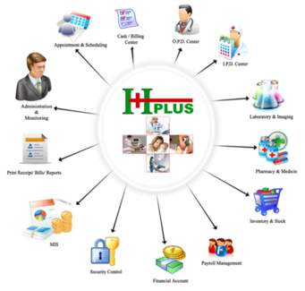
Hospital is a place where no one willingly wants to visit but there are times when we need to

Slide 2
Team Member:-
Name: ID:
Zulkar Nine 163432601
Md.Faruqe Hasan 163432560

Slide 3
Welcome To Our Presentation

Slide 4
Presentation topic: Hospital Management System

Slide 5
What is Hospital management system:
Hospital management system (HMS) is an element of hospital informatics solutions that focuses mainly on the administration needs of hospitals. An HMS is a computer or web-based application that manages the functioning of an entire hospital.
. Our main focus is to make peoples life easier in the hour of need. We are working to design such a system that will reduce a lot of paperwork and save peoples time.

Slide 6
Background History
. The hospital system has been automated but the benefit is not for all. In such a situation we have figured out that there should be something for the patients. Some simple features for checking appointment, asking for appointment, prescription and test reports can reduce the hassle up to 70-80%. Because those are the sector where we face a lot of trouble and can find a way out. So this will allow us something that we were waiting for so long.
The world is moving to internet so this is the right time to think about this. If a system does not provide help for every user group then it cannot be perfect system. We came out a long way with maximizing benefit for all.

Slide 7
Requirement:
Functional:
1. Patient information.
2. Clinical laboratory, radiology, and patient monitoring. 3. Patient census and billing. 4. Staffing and scheduling. 5. Outcomes assessment and quality control. 6. Pharmacy ordering, prescription handling, and pharmacopoeia information.
7. Finance and accounting.
8. Supplies, inventory, maintenance, and orders management.

Slide 8
Non-Functional:
1. Access to information. 2. Improvement in quality of documentation. 3. Improving quality of patient care. 4. Improvement in communications. 5. Reduction in medication errors. 6. Reduction in hospital costs. 7. Enhancing ability to track patient's record.

Slide 9
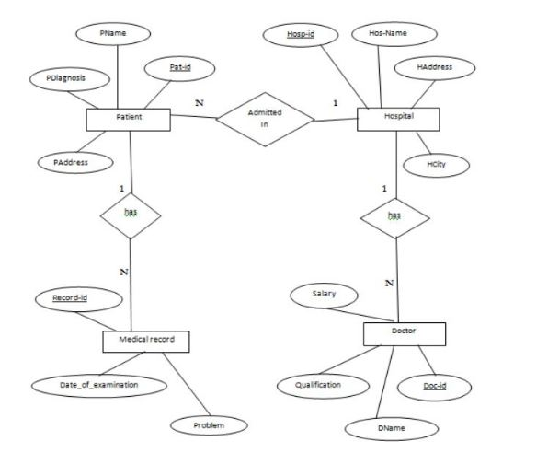
E-R Diagram:

Slide 10
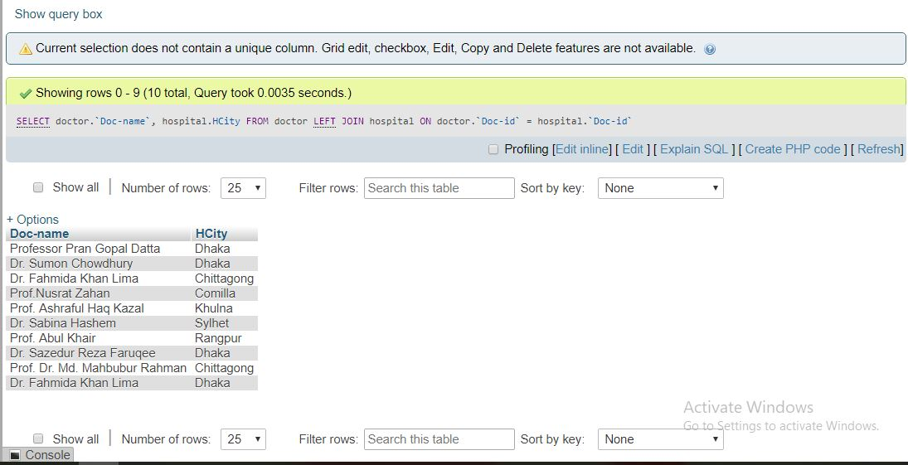
Joining table:

Slide 11
Advantage:
Immediate Access of data and Time Saving
Data can be easily insert/update/delete.
Ensure consistent correspondence between an individual doctor and his patients.
Save money and energy to the employees, improve service quality.
Decrease use of emergency department.
Increase outpatient care, decrease surgeries need to hospitalization.

Slide 12
Disadvantage:
Increase workload for employees and decrease job satisfaction.
Lack the skills of Managers to contract with private sector and lack of powerful private sector caused outsourcing is failed.
Impact on the quality was low but costs was reduced.
Increase workload and decrease in mental capacity of employees.
May require additional hardware/software, which increases costs and logistics.

Slide 13
Future work:
. Modify as a web application targeting all doctors.
Blood Bank Information Management .
A mobile application to make things easy and bring them closer.
Directly getting the images for CT Scan or X-Rays from connected device.
Producing ECG using connected device.
Video Conferencing facility for remote areas for treatments .

Slide 14
Conclusion:
This was an excellent project to work on and I have learned a lot of things to complete this project. I want to keep working on it to give it a better shape.
We build tools and machines to make our lives easy and more comfortable. Since then we have never stopped to build or design new things. We are hopeful that someday this will be the reality of your hospital experience.

Slide 15
Thank You

